Slide 1


Why study Data Science?
Project 3 - Data Analytics
By Mylene Marsden

Slide 2



Data Science Careers?
High demand role?
High Paying Jobs?
Average Salaries?
Job Flexibility?
Mylene Marsden
Project 3 – Data Analytics

Slide 3
Part 1 – Data source and Dashboard

Slide 4
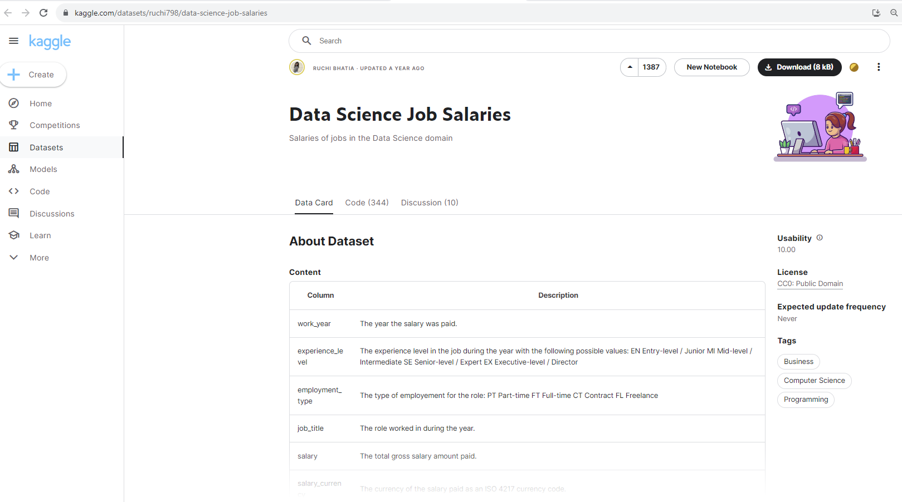
Data Source
LINK :
https://www.kaggle.com/datasets/ruchi798/data-science-job-salaries
Have analyzed 4134 Kaggle records for review across the globe.
The salary is based on US Dollar ($).
Mylene Marsden
Project 3 – Data Analytics

Slide 5
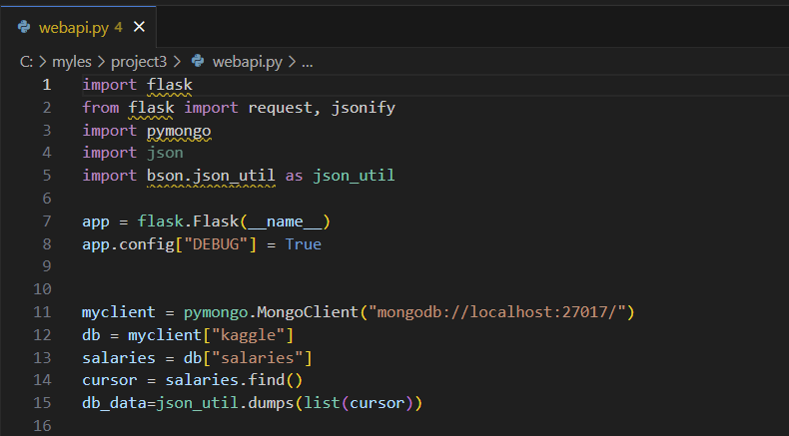
webapi
- “mongodb”’ database used
- created “webapi”
- used “flask” in generating ($) salaries
Mylene Marsden
Project 3 – Data Analytics

Slide 6
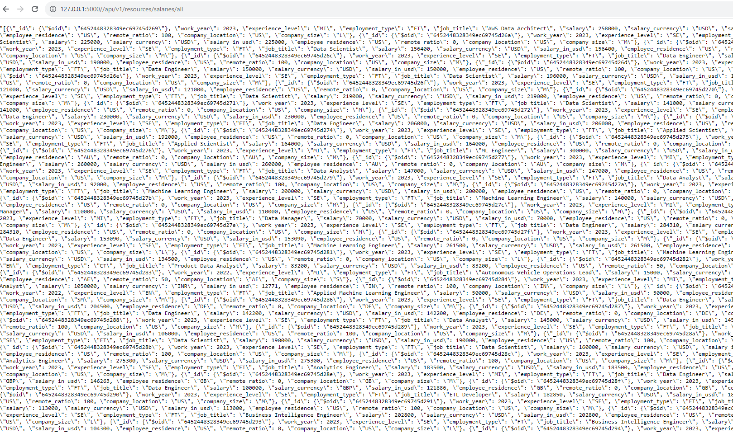
webapi
Link : http://127.0.0.1:5000/api/v1/resources/salaries/all
-webapi response run locally
Mylene Marsden
Project 3 – Data Analytics

Slide 7
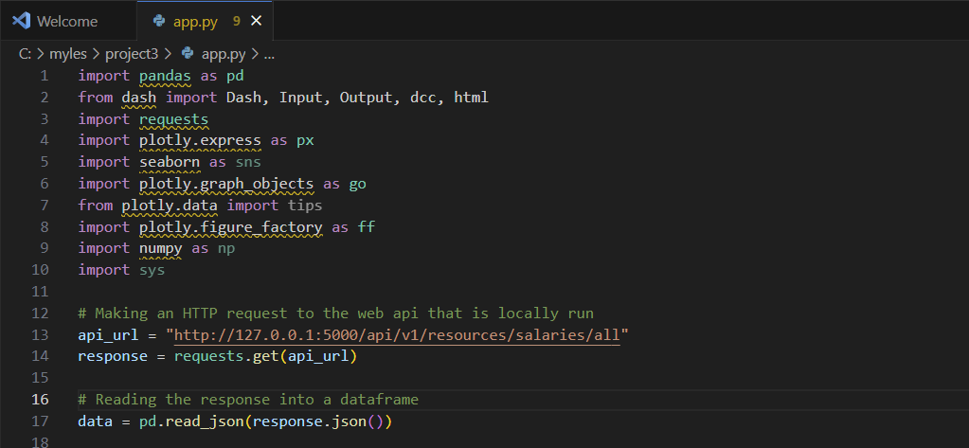
Dashboard
- using “dash” for dashboard
- using “plotly” for charts
endpoint being consumed by the dashboard
Mylene Marsden
Project 3 – Data Analytics

Slide 8
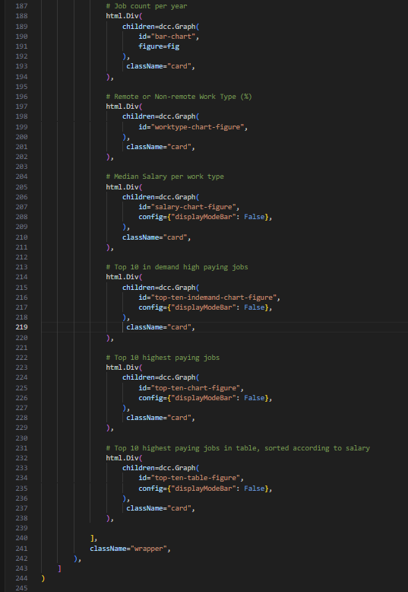
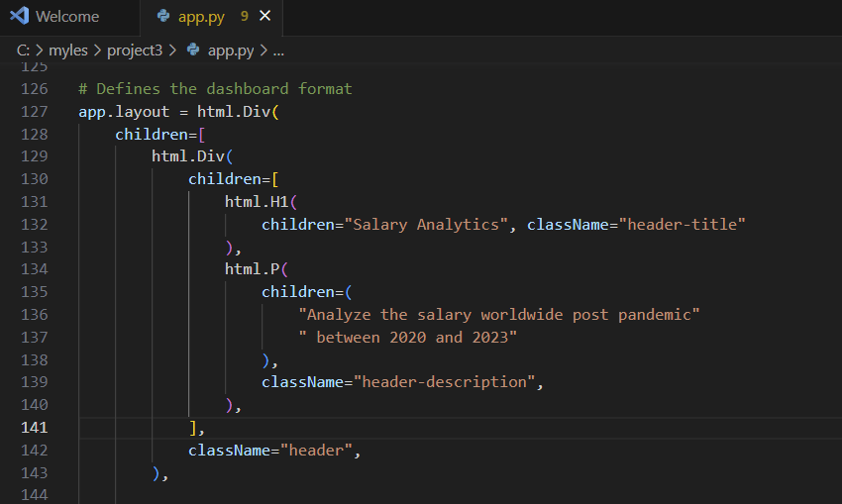
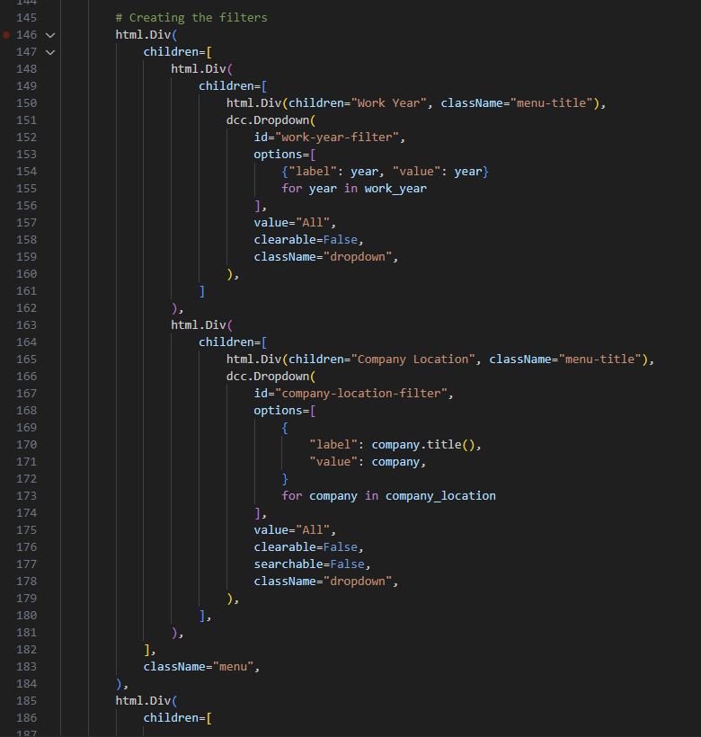
Dashboard - Format and Filter
- Dashboard format
- Dashboard filter
Mylene Marsden
Project 3 – Data Analytics

Slide 9
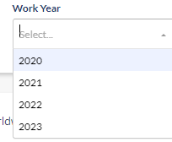
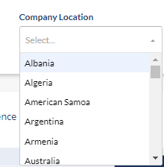
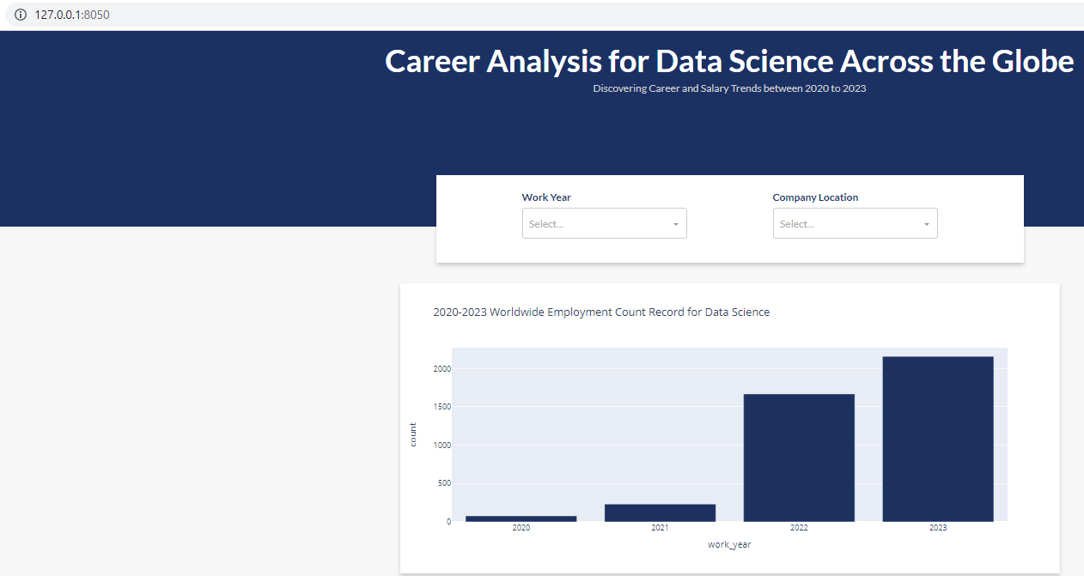
Dashboard Filter
by YEAR :
Link : http://127.0.0.1:8050/
by COUNTRY :
Mylene Marsden
Project 3 – Data Analytics

Slide 10
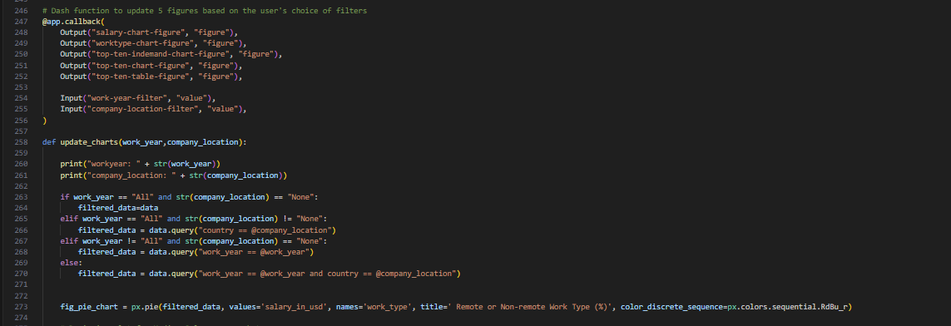
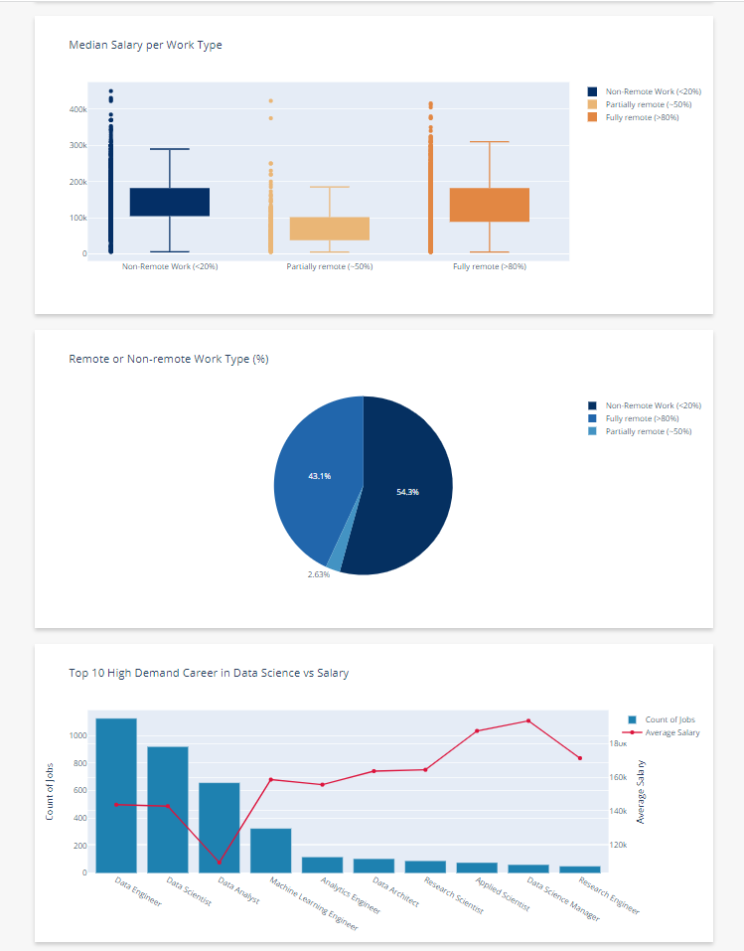
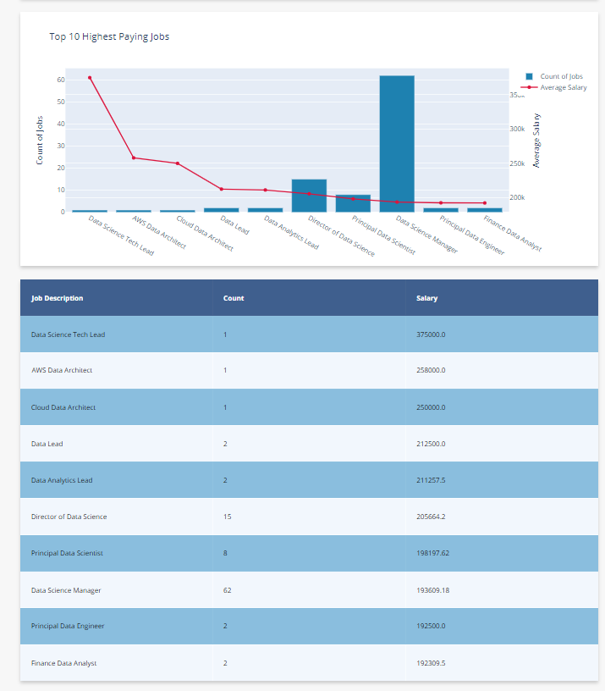
Dashboard Charts
- dash function in updating 5 figures based on user’s choice of filter
Mylene Marsden
Project 3 – Data Analytics

Slide 11
Part 2 – Data Analysis

Slide 12
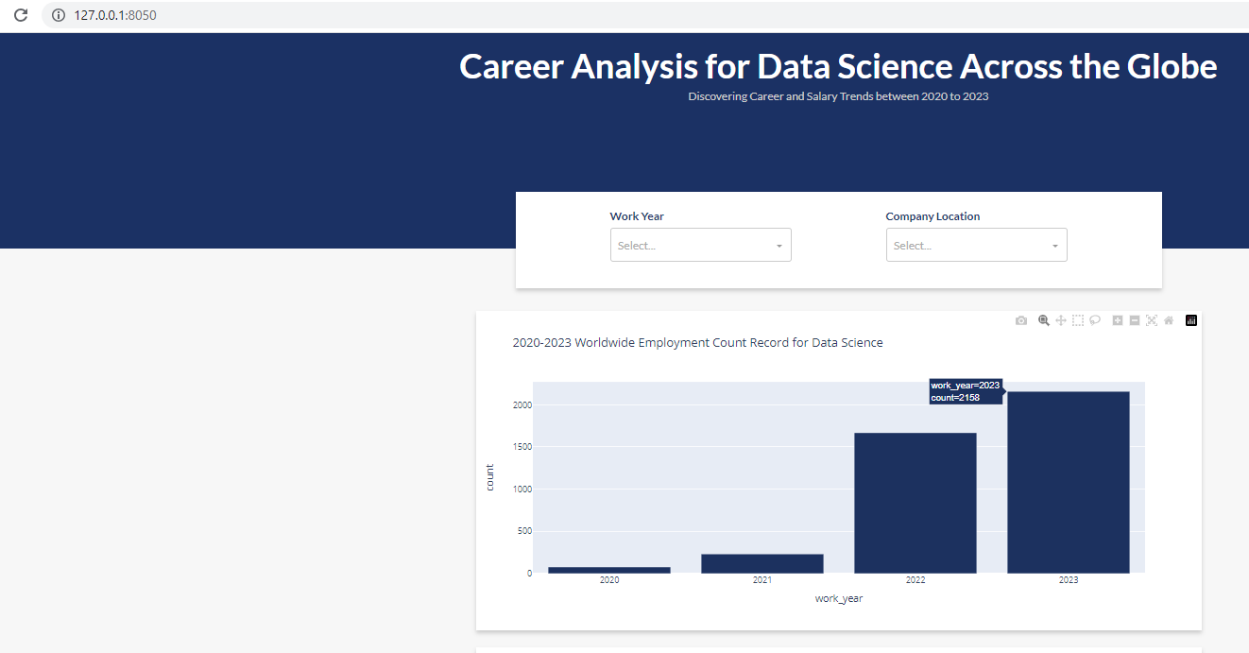

2020-2023 Worldwide Employment Count Record for Data Science
Job Count Trend by Year:
2023 - 2158
2022 - 1668
2021 - 231
2020 - 77
Between 2020 and 2023, there has been a noteworthy surge in the demand for careers in the field of data science. The analysis of the data indicates a significant increase in the year 2022 as compared to the previous year, 2021. Furthermore, the trend analysis suggests that the year 2023 is also showing an upward trend.
Mylene Marsden
Project 3 – Data Analytics

Slide 13

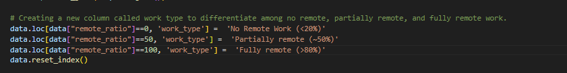
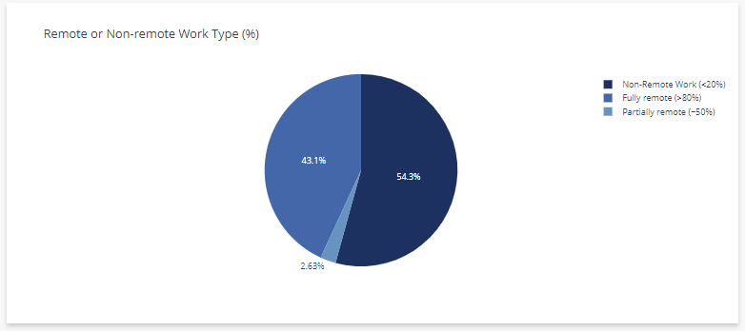
Job Flexibility in Data Science Careers
The data suggests that remote work is a viable option for those pursuing a career in data science, as the results obtained from remote and non-remote positions were found to be comparable.
Mylene Marsden
Project 3 – Data Analytics
Notes:
The data analytics report indicates that remote work is a feasible alternative for individuals seeking a career in data science beyond the conventional office-based roles.

Slide 14

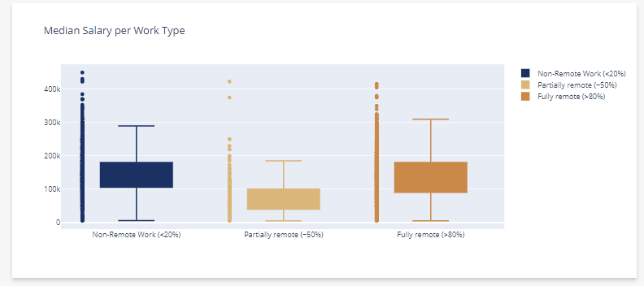
Comparing Salaries (US $) : Remote vs Non-Remote Work
Data science careers can anticipate comparable compensation for both remote and non-remote work arrangements.
Mylene Marsden
Project 3 – Data Analytics

Slide 15
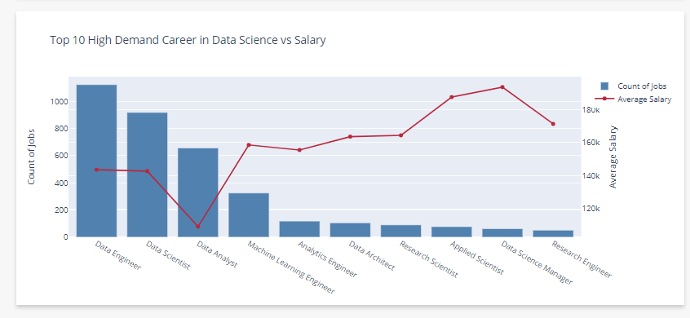
High Demand Careers of Data Science vs Salary (US $)
The data reveals that the data engineer role is the most in-demand position within the data science field, followed by data scientist, data analyst, and machine learning engineer. Despite their high demand, these positions rank within the bottom 3 in terms of salary among the top 10 sought-after jobs in data science. Conversely, the machine learning engineer position, which ranks fourth in terms of demand, boasts the highest salary compared to these positions.
The Data Analyst profession is ranked as the lowest in terms of salary among the top 10 data science careers. However, it holds the 3rd position in terms of high demand for jobs in this field.
Mylene Marsden
Project 3 – Data Analytics

Slide 16
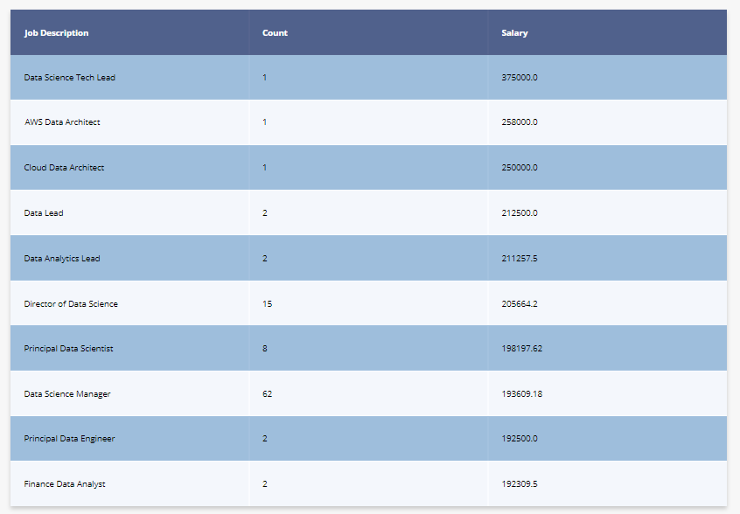
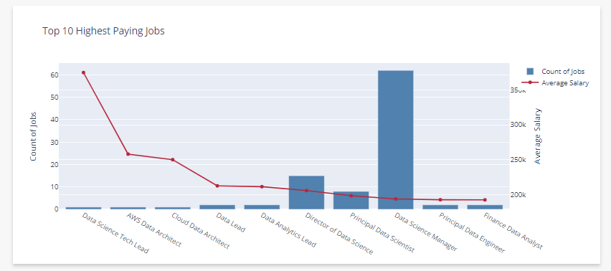
Highest Paying Jobs in Data Science Careers (US $)
The report highlights that data architects, data engineers, and machine learning engineers are among the top high-paying jobs in the field of data science careers . Although it is worth noting, that the data reveals a singular count for each result.
The role of Data Science Manager demonstrates the highest count among the top-paying positions within the Data Science field, while ranking 8th in terms of highest salary.
Additionally, the Director of Data Science is another top-paying position, coming in second in terms of employee count and sixth in terms of salary.
Mylene Marsden
Project 3 – Data Analytics

Slide 17
Is Data Science a good career option?
Data science is a promising career choice with numerous job opportunities due to its growing popularity since 2020.
Data science provides various job opportunities, including data analyst, machine learning engineer, business intelligence analyst and etc, enabling people to choose a career that matches their skills and preferences.
Data science careers are versatile and can be found in various industries with different specialisations.
Data science career is a flexible option for both remote and non-remote work arrangements. This career path is attractive to those who want work-life balance or remote work options due to its flexibility.
Mylene Marsden
Project 3 – Data Analytics

